Slide 1
PRAKRITI-2020
TEAM NAME - ANALYTIX
SUMIT KUMAR AGRAWAL | SHIRSHA CHOWDHURY | ROHIT SINGH TOMAR | IKSHU MANJAN
9462784561 | 90514012131 | 8109137158 | 86695189359
IIT KHARAGPUR | IIT KHARAGPUR | IIT KHARAGPUR | IIT KHARAGPUR

Slide 2
DATA DESCRIPTION
ELEMENTAL
SPECTRAL
Potassium
Stronsium
Wavelength ranging from 351 nm
Aluminium
Titanium
Sulphur
Potassium
To 2499 nm
Iron
Calcium
To 2499 nm
Silicon
Zinc
Rubidium

Slide 3
GEOGRAPHICAL DISTRIBUTION
1
HOU
20%
28%
4
2
NMX
39%
ITA
3
11%
LBB

Slide 4
METHODOLOGY
Analyzed the data
1
6
Reported the most optimal metric
Cleaned the data
2
5
Tested the hypothesis by predicting
Data visualization
3
4
Formed the hypothesis

Slide 5
METRIC USED FOR CHECKING PERFORMANCE OF MODELS
ROOT MEAN SQUARED ERROR (RMSE)
1
N
RMSE=
2
(y_predicted-y_test)
N=TOTAL SIZE OF DATASET OVER WHICH y_predicted IS PREDICTED

Slide 6
01
Linear regression
02
Random forest regressor
03
Gradient boost regressor
DIFFERENT MODELS USED
04
K nearest neighbour
05
Ada boost regressor
06
XG boost regressor
07
Decision tree regressor

Slide 7
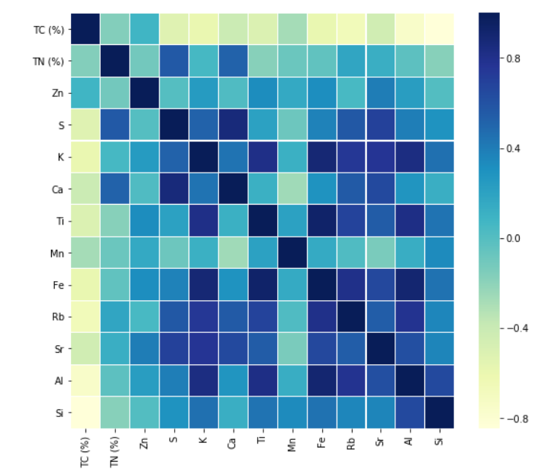
HEAT MAP

Slide 8
DATA VISUALISATION USING TC(%) VS DIFFERENT METALS

Slide 10
DATA VISUALISATION USING TN(%) VS DIFFERENT METALS

Slide 11
MODELS WITH THEIR METRIC SCORE
MODELS USED | RMSE(TC) | RMSE(TN)
Linear Regression | 2.226 | 0.191
Decision Tree Regression | 2.645 | 0.252
KNN-Regressor | 2.345 | 0.149
Random Forest Regressor | 2.160 | 0.188
Ada-Boost Regressor | 2.426 | 0.189
Gradient Boost Regressor | 2.122 | 0.169
XG Boost Regressor | 1.696 | 0.170

Slide 12
DATA VISUALISATION OF TC(%) AT DIFFERENT WAVELENGTHS

Slide 13
FIRST ORDER REFLECTANCE VALUES FOR A PARTICULAR SAMPLE

Slide 14
FINAL PREDICTIONS USING SPECTRAL DATASET
MODELS USED | RMSE(TC) | RMSE(TN)
Linear Regression | 2.906 | 0.162
Decision Tree Regression | 4.047 | 0.328
KNN-Regressor | 2.329 | 0.260
Random Forest Regressor | 2.553 | 0.228
Ada-Boost Regressor | 1.835 | 0.219
Gradient Boost Regressor | 2.458 | 0.206
XG Boost Regressor | 2.329 | 0.208

Slide 15
FINAL PREDICTIONS USING COMBINED DATASET
MODELS USED | RMSE(TC) | RMSE(TN)
Linear Regression | 2.160 | 0.138
Decision Tree Regression | 3.896 | 0.334
KNN-Regressor | 2.345 | 0.218
Random Forest Regressor | 2.424 | 0.196
Ada-Boost Regressor | 1.565 | 0.183
Gradient Boost Regressor | 2.056 | 0.192
XG Boost Regressor | 2.013 | 0.194

Slide 16
CONCLUSION
COMBINED MODEL
INDIVIDUAL MODELS

